Slide 1
RackSched: A Microsecond-Scale Scheduler for Rack-Scale Computers
Hang Zhu
Kostis Kaffes, Zixu Chen, Zhenming Liu, Christos Kozyrakis, Ion Stoica, Xin Jin
Notes:
Hello everyone, today I will present our work RackSched:…

Slide 2








Online services require low tail latency
Low tail latency: 10s~100s of microseconds
Notes:
online services require low tail latency. Example systems include Key-value stores, search ranking, transactional database and graph stores.
They are expected to provide high tput with low tail latency in the range of
tens to hundreds of microseconds

Slide 3
How to serve microsecond-scale workloads?
Scale up
[Shinjuku, NSDI’19]
Request
Queue
Centralized scheduling policies
cFCFS (centralized first-come-first-serve)
PS (processor sharing)
Dispatcher core
Worker cores
A multi-core server
Notes:
To meet microsecond level tail latency requirement, people designed data plane Oses to realize the scheduling policies and scale up to the multiple cores in a single server. Here we take Shinjuku as an example. Shinjuku uses efficient mechanisms to implement preemption and context
switching, and it has a dispatcher core working as an intra-server scheduler that can run centralized scheduling policie, such as cFCFS or PS across the worker cores to avoid head-of-line blocking and address temporal load imbalance between multiple cores.
cFCFS which is short for centralized first-come-first-serve, is a near-optimal scheduling policy for low-dispersion workloads, and PS(…), is near-optimal for heavy-tailed workloads or light-tailed workloads with high dispersion.

Slide 4
How to serve microsecond-scale workloads?
Scale up
[Shinjuku, NSDI’19]
Larger demands
Scale out
Request
Request
Worker threads
Worker threads
Worker threads
Worker threads
A rack-scale computer
Notes:
However, as application demands continue to increase, scaling up is not enough. Serving larger demands require scaling out to multi servers in a rack, which is termed as rack-scale computers, such as Berkeley Firebox, Intel Rack Scale Architecture and HP “The Machine”

Slide 5
Can we do centralized scheduling?
Centralized scheduling cannot scale
Request
Queue
Centralized scheduler
Worker threads
Worker threads
Worker threads
A rack-scale computer
Notes:
Naively, we want to implement the centralized scheduling policies, such as cFCFS, PS across all the cores in the rack
However, directly implementing the centralized policies is challenging because they would require a centralized scheduler for the entire rack.
While a single core is capable to handle the requests for a
multi-core server, it is unlikely to scale to a multi-server rack with hundreds to thousands of cores.

Slide 6
Our proposal: hierarchical scheduling
Centralized scheduling cannot scale
Hierarchical scheduling
Load imbalance
Request
Inter-server scheduler
Queue
Intra-server scheduler
Intra-server scheduler
Intra-server scheduler
Workers
Notes:
Our proposal is a two-layer hierarchical scheduler, consisting of an inter-server scheduler at the high level, and
per-server schedulers at the low level.
The key insight is that there are two sources of long tail latency—load imbalance, which means different queue lengths on different servers

Slide 7
Our proposal: hierarchical scheduling
Centralized scheduling cannot scale
Hierarchical scheduling
Load imbalance
Head-of-line blocking
Request
Inter-server scheduler
Queue
50
HOL blocking
500
Intra-server scheduler
Intra-server scheduler
Intra-server scheduler
Workers
Notes:
and head-of-line blocking (which means Short requests get stuck behind long ones).
These two sources can be decoupled and handled by separate mechanisms.
The inter-server scheduler handles the load imbalance and the intra-server scheduler handles the HOL blocking

Slide 8
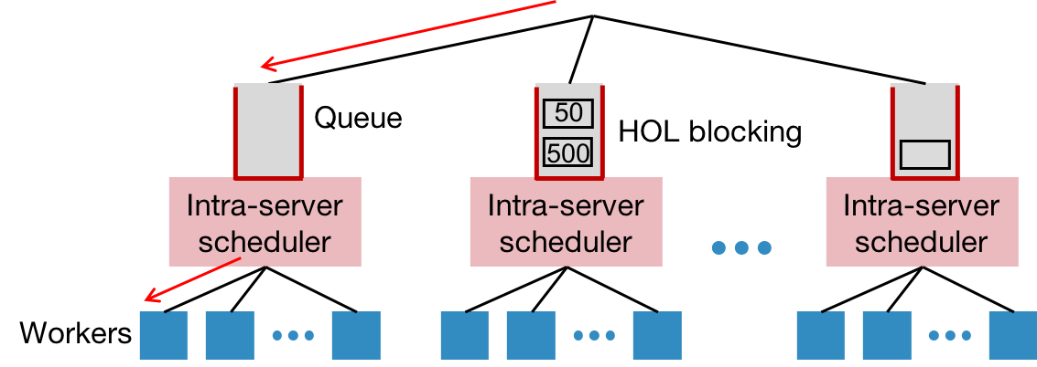
Inter-server scheduler
Scaling the inter-server scheduler
Programmable switches
Join-the-shortest-queue (JSQ) is bufferless
Approximating JSQ
Power-of-k-choices
Request
Inter-server scheduler
Notes:
While the inter-server scheduler only needs to schedule requests across the servers in the rack instead of across all cores, it still needs to
handle every request, which is hard to do on a commodity server. We turn to programmable switches which can process the requests for a rack at line rate.
A natural way to approximate a centralized scheduler with a two-layer scheduler
Is to implement the same scheduler on both layers. For example, if the global scheduler is cFCFS, all the inter-server and intra-server schedulers
will be cFCFS as well. But the cFCFS scheduler needs to maintain a queue to buffer requests, which is challenging to do on existing programmable switches.
JSQ (join-the-shortest-queue) can address this challenge because it‘s bufferless. Upon a request arrival, it
immediately forwards the request to the server with the shortest queue.
While conceptually simple, JSQ requires the switch to know the exact queue length of each server when scheduling a request.
imperfect JSQ based on delayed server status is
prone to herding, where several consecutive requests are sent
to the same server before the server load is updated
So we use pok to approximate JSQ, which samples k servers for each request and chooses the one with the minimal load.

Slide 9
A distributed, client-based inter-server scheduler?
Client complexity
Overhead for reconfiguration
Worse scheduling quality
Client 1
Client 2
Client n
Queue
50
500
Intra-server scheduler
Intra-server scheduler
Intra-server scheduler
Workers
Notes:
Someone may ask why not choose a distributed… where each client maintains the queue lengths and does power-of-k choices by its own.
There are mainly three reasons. first, it increases client complexity. The clients have to maintain the queue lengths and do
pok by itself. Second, each client has to be notified by server reconfigurations, including server removal and addition.
Third, we can image that given n clients with the same sending rate, a centralized scheduler can utilize n times as
much probing data as that of one client. So client-based solution has worse scheduling quality

Slide 10
How to realize the two-layer scheduling framework?
What is the system architecture?
How to process/schedule requests based on the server loads?
How to ensure request affinity?
How to handle practical scheduling requirements?
Notes:
So how to …
Basically , we need to answer the following four questions:…

Slide 11
How to realize the two-layer scheduling framework?
What is the system architecture?
How to process/schedule requests based on the server loads?
How to ensure request affinity?
How to handle practical scheduling requirements?

Slide 12
RackSched architecture
Client
Client
Client
Rack-Scale Computer
Inter-server scheduling
Handle temporal load imbalance
Intra-server scheduling
Handle head-of-line blocking
L2/L3
Routing
Request
Scheduling
Request
Affinity
Server
Tracking
ToR Switch
Inter-Server Scheduler
Intra-Server
Scheduler
Intra-Server
Scheduler
Intra-Server
Scheduler
Worker Threads
Worker Threads
Worker Threads
Notes:
we propose RackSched that integrates inter-server scheduling in the ToR switch to address temporal load imbalance between servers and intra-server scheduling in each server to alleviate HOL blocking. The ToR switch performs interserver scheduling at per-request granularity via three modules:
First, a request scheduling module that selects a server for a new incoming request based on server loads;
Second, a request affinity module that forwards the packets of the same request to the same selected server,
and last, a server tracking module that tracks the real-time load on each server.
All three modules are implemented in the switch data plane and run at line rate. Each server has a centralized scheduler to queue and schedule requests to its own workers.

Slide 13
How to realize the two-layer scheduling framework?
What is the system architecture?
How to process/schedule requests based on the server loads?
How to ensure request affinity?
How to handle practical scheduling requirements?
Notes:
The second question: how the inter-server scheduler process and schedule…

Slide 14
Packet format
Existing Protocols
RackSched Header
ETH
IP
TCP/UDP
TYPE
REQ_ID
LOAD
Payload
L2/L3 Routing
reserved
port #
REQF, REQR,
REP, etc.
Notes:
This figure shows the racksched header, which consists of three fields, TYPE, indicating the packet type; REQ_ID,
used to ensure request affinity and LOAD to store the real-time queue length of the server.
RackSched is orthogonal to and compatible with other network functionalities, such as flow/congestion control, which is typically implemented by the transport layer or the RPC layer.
It only requires to add the racksched header at the beginning of the payload.

Slide 15
Request processing
Insert
Read
Intra-Server
Scheduler
The 1st packet of a request
ReqTable
LoadTable
Client
ToR Switch
Server
Read
Intra-Server
Scheduler
The following packets of the request
ReqTable
LoadTable
Client
ToR Switch
Server
Remove
Update
Intra-Server
Scheduler
The reply packets
ReqTable
LoadTable
Client
ToR Switch
Server
Notes:
To process requests, the switch keeps two sets of state. One is ReqTable which stores the mapping from the request IDs to the servers, and the other is LoadTable which stores the queue lengths of the servers.
When the 1st arrives, the switch selects a server based on LoadTable and remember the selection by inserting an entry to the ReqTable.
When remaining packets of the request arrive, the switch checks the ReqTable to get the selected server, which ensures the request affinity
For reply packets, it deletes the mapping from ReqTable and update the load in LoadTable

Slide 16
Request scheduling
Match | pkt.dstip == 10.0.0.1
Action | meta.load_i = array[rand_i].load meta.ip_i = array[rand_i].ip
0 | 1 | 2 | 3
1.0.0.1 | 1.0.0.2 | 1.0.0.3 | 1.0.0.4
20 | 10 | 30 | 5
Register Array
zoom-out
rand1
min()
rand2
min()
rand3
min()
rand4
power of k choices to
sample k servers
tree-based parallel
computation of min()
Notes:
The server ip and the corresponding load are stored in a register array.
With a sampled server, the ip and load is loaded into metadata fields.
To implement power-of-k choices, the switch samples k servers and then chooses the one with the shortest queue from them.
Instead of using multiple stages to scan the server loads linearly,
we use the tree-based parallel computation to compute the minimal with fewer stages. the comparisons between two servers in each layer of the tree have no dependencies. So they can be done in parallel in the same stage.

Slide 17
How to realize the two-layer scheduling framework?
What is the system architecture?
How to process/schedule requests based on the server loads?
How to ensure request affinity?
How to handle practical scheduling requirements?

Slide 18
Request affinity
Stage 1
Stage 2
Stage 3
Req. ID | Server IP
1 | 1.0.0.1
3 | 1.0.0.2
Req. ID | Server IP
2 | 1.0.0.4
5 | 1.0.0.3
Req. ID | Server IP
4 | 1.0.0.4
7 | 1.0.0.3
6 | 1.0.0.2
h₁(pkt.req_id)
h₂(pkt.req_id)
h₃(pkt.req_id)
Insert: iterate over stages to find an empty slot
Read: find a matched slot to read the server IP
Remove: remove a completed request
Notes:
To ensure the request affinity, the switch keeps the state in the ReqTable.
We build a multi-stage hash table to handle hash collisions that supports all necessary operations, including insert, read and remove.
For insertion, the switch iterates over the stages to find an empty slot to insert a new request. For read, the switch finds the matched slot to read the server IP. For removal, the switch also iterates over the stages and removes the completed request.

Slide 19
How to realize the two-layer scheduling framework?
What is the system architecture?
How to process/schedule requests based on the server loads?
How to ensure request affinity?
How to handle practical scheduling requirements?

Slide 20
Handling scheduling requirements
Multi-queue support
Separate queue for each request type on each server
Locality and placement constraints
Data locality
Request dependency
Resource allocation policies
Strict priority
Weighted fair sharing
Check our paper for more details
Notes:
RackSched is a general approach that can handle many scheduling requirements.
Such as multi-queue support, which means we can have separate queue for each request type on each server.
Applications indicate the request type in the TYPE field of the RackSched header. The
switch maintains the counters for each type in LoadTable, and schedules requests based on the queue lengths of the request type.
RackSched handles two types of common locality and placement constraints, which are data locality and request dependency.
To support data locality, applications set different LOCALITY values to represent different locality requirements.
Request dependency is supported using request affinity: relevant requests carry the same REQ_ID in their headers, so that they will be sent to the same server.
RackSched also supports two resource allocation policies, including strict priority and weighted fair sharing. You can check our paper for more details

Slide 21
Implementation
Switch
6.5Tbps Barefoot Tofino switch
Written in P4
Server
8-core CPU and 40G NIC
Shinjuku
Client
Intel DPDK 16.11.1
https://github.com/netx-repo/RackSched
Notes:
We have implemented a RackSched prototype, consisting of three parts.
For switch, we use Barefoot Tofino switch and the switch program is written in p4.
Each server machine has an 8-core cpu and one 40G NIC. We run shinjuku on the server machines
The client used to generate requests is open-loop and implemented with Intel DPDK
The prototype is available on this github link.

Slide 22
Evaluation
Does RackSched improve the performance?
Does RackSched scale?
Does RackSched benefit applications?
What is the impact of the design decisions?
Does RackSched ensure request affinity?
Notes:
The evaluation consists of the following parts

Slide 23
Evaluation
Does RackSched improve the performance?
Does RackSched scale?
Does RackSched benefit applications?
What is the impact of the design decisions?
Does RackSched ensure request affinity?
Notes:
In this talk, we talk about the first four

Slide 24
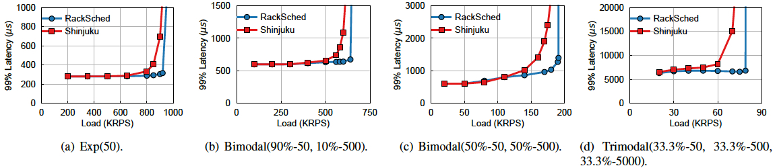
Does RackSched improve the performance?
RackSched supports larger throughput with lower tail latency
Notes:
We use four representative service time distributions for synthetic workloads, including an exponential distribution, two bimodal distributions and one trimodal distribution
We compare RackSched with that directly runs Shinjuku in the cluster, where the requests are
randomly sent to the servers.
At first, we evaluate it with homogeneous servers. There are 8 servers in the rack and each server has 7 worker cores, 1 core is used as intra-server scheduler.

Slide 25
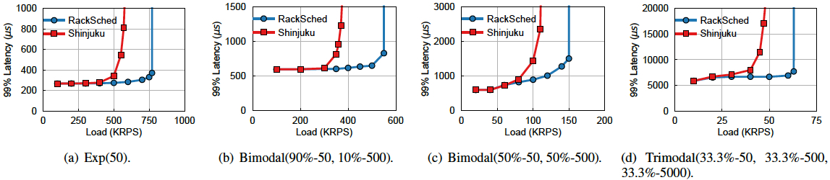
Does RackSched improve the performance?
RackSched improves the throughput further by up to 1.44X
Notes:
Then we evaluate RackSched under synthetic workloads with heterogeneous servers. In this case, four servers have four workers and the other four servers have seven workers.
This evaluates the cases when some servers are slower or some cores of these servers are grabbed for other purposes

Slide 26
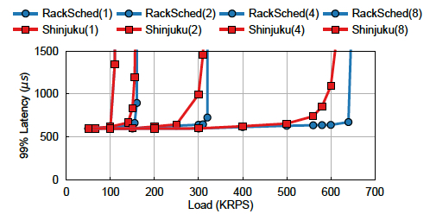
Does RackSched scale?
RackSched scales out the throughput near linearly
The throughput is increased without increasing the tail latency
Notes:
The key benefit of RackSched is that it enables the system to scale out by adding servers, while achieving low tail latency at high throughput. This figure demonstrates such benefit

Slide 27
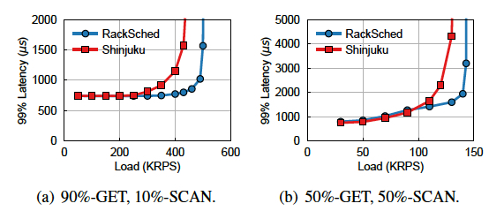
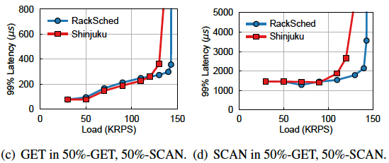
Does RackSched benefit applications?
RackSched does not sacrifice any individual request type
Notes:
We port RackSched to RocksDB and use two distributions to evaluate RackSched with the real application workloads,
Including a 90%-GET, 10%SCAN, and 50%-get, 50%-scan
We break down the latency of the 50%-GET, 50%-SCAN in figure(c)(d).
And we can see the improvement of RackSched over all requests does not come at the cost of sacrificing any individual request type.

Slide 28
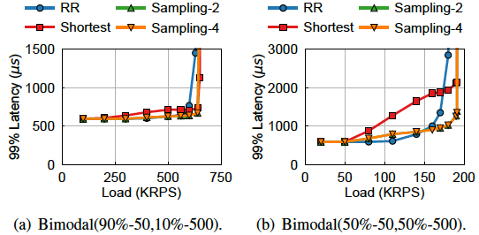
Design decisions: switch scheduling policies
RR: without considering the variability of service times
Shortest: the herding behavior
Notes:
Then, we tried different scheduling policies on switch, including RR, Sampling-2 (po2), sampling-4(po4),
shortest (which choose the server with the smallest queue length)
sampling two and four servers have similar performance, because they
both provide enough randomization in such scale.
Round-robin does not consider the variability of service times. And shortest has the herding behavior. So they perform worse.

Slide 29
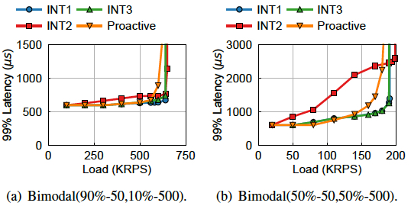
Design decisions: load tracking mechanisms
INT2: only track the minimal number of outstanding requests
INT3: track the total service time of outstanding requests
Proactive: increment and decrement the counters by the switch
Notes:
This figure shows the impact of different server load tracking mechanisms.
INT1 is used by RackSched
INT2 only tracks..., resulting in herding
INT3 tracks .... It has nearly the same performance as INT1, but it presumes knowing the service times as a priori which is normally not the case in practice.
Proactive increments and ... It cannot precisely maintain the queue length for each server as packet loss and retransmissions can introduce errors on the counters

Slide 30
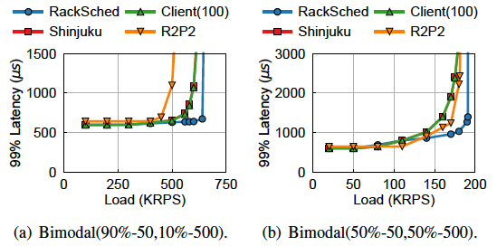
Design decisions: comparing with other solutions
Client(100) has nearly the same performance as Shinjuku
R2P2 has head-of-line blocking
Notes:
Then we compare RackSched with client-based solution and R2P2, which is a recent solution that proposes a join-bounded-shortest-queue policy for request scheduling. And R2P2 can also be implemented on a programmable switch.
Client(100) means we are simulating 100 clients. The results for 1000 clients and 10 clients are similar. Each client performs the same policy as RackSched and tracks server queue lengths via piggybacking by its own.
The client-based solution has nearly ...
R2P2 does not have preemptive intra-server scheduling and has head-of-line blocking.

Slide 31
Conclusion
Emerging workloads require microsecond-scale tail latency
RackSched is a rack-level microsecond-scale scheduler that achieves scalability and low tail latency
Use a two-layer scheduling framework
Ensure request affinity
Support practical scheduling policies
Notes:
To conclude, Emerging workloads require microsecond-scale tail latency.
And RackSched is a rack-level microsecond-scale scheduler that achieve scalability and low tail latency by leveraging a two-layer scheduling framework. It can also ensure request affinity and support practical scheduling policies.

Slide 32
Thanks!
E-mail address: hzhu@jhu.edu
https://github.com/netx-repo/RackSched
Notes:
That’s all and thanks for listening.

